Slide 1


GoLearn
Students can learn from anywhere via virtual labs
Plugin_Mind
Ishan Sethi
Aishwarya Jaiswal
Pooja Mandal
EDUTHON-EDUCATION THEMED HACKATHON
01

Slide 2
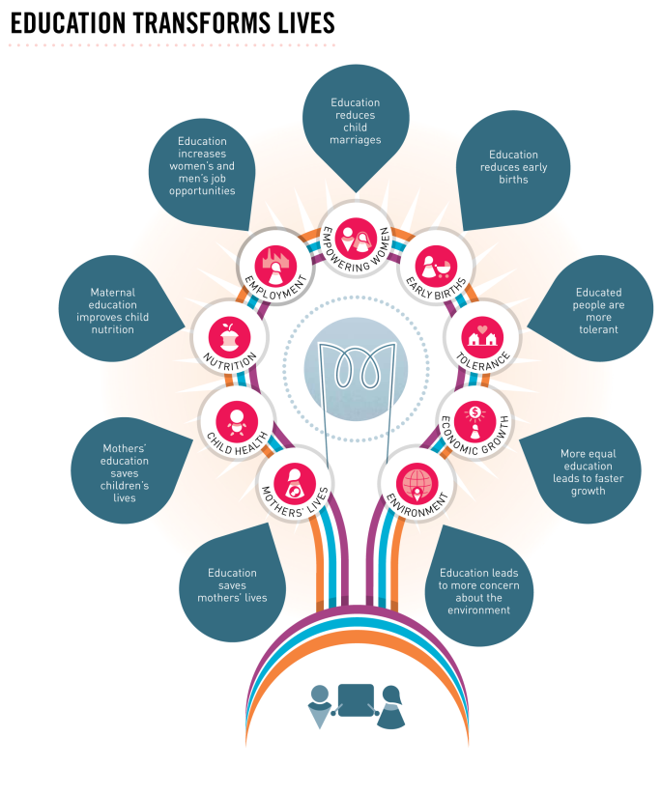
PROBLEM STATEMENT
Education is important for everybody, whether they are learning new facts, skills, or trades. Having the opportunity to learn always benefits the individual. However, if we take a step further, we can think about educating communities, specifically rural communities.
Students living in rural area cannot afford to have the best quality education due to the lack of resources.
During the time of covid-19 global pandemic where education of several students suffering a lot and teachers are also not able to give the quality education as they can’t keep eyes on every single student and they can’t stop cheating happens during the exam.
What could be the possible solution for this.

Slide 3

PROPOSED SOLUTION
We have taken an initiative to make education more accessible for students living in rural areas through GoLearn.
We at Plugin_mind believe education is not only what school teaches us, but also think students should learn about other things that'll help them in life. The golden ratio is one such topic. Not only we have given students with definition & mathematical derivation but also some interesting examples. Moreover, we have added some interactive tabs to it. These tabs make the learning part more interesting & students will get fascinated by them. Teachers can use it to understand students better. In these challenging times, teachers are doing their level best not to let students' education down. Using this detector, the teachers can check whether or not the students have understood the topic. Also, using this, teachers can keep an eye on students while doing online exams. It'll help reduce the chances of malpractices.

Slide 4

4.
UNIQUE SELLING POINTS
INTERA CTIVE TABS →These tabs make the learning part more interesting and students will get fascinated by them .
1.
FEATURES LIKES CREATIVE LEARNING ZONE → Students can learn new things here. It’s get updated every 7 days. Virtual Labs & other things make the learning process interesting.
5.
CHEATING → It’ll help reduce malpractices during online exams and with the help of this teacher can keep an eye on every student.
2.
REDEEM PAGE → You can earn points and can redeem your points against the provided services
6.
A/B TESTING REPORT & VIRTUALL GUITAR SUBSCRIPTION FOR 5 HOURS OF FREE FOOD & LIVE GOLDN RATIO DETECTOR FOR MATHEMATICS & DESIGNERS ON PAID SUBSCRIPTION AFTER 5 USES.
3.
EMOTION DETECTOR → It can be used to detect to detect multiple things. While teacher is teaching ,it will help the teacher to understand whether or not the students got the topic.. Teacher’s can also use this platform so as to reduce the chances of cheating.
7
SURVEY REPORT ANALYSIS FOR FOOD & SURVEY REPORT ANALYSIS FOR OTHER ITEMS .

Slide 5











YOUR TECH STACK

Slide 6
THANK YOU

